Slide 1

Don’t get kicked!
Data Mining(CS 6220)
Professor Sara Arunagiri
Team Members:
S. Negin Mortazavi
mortazavi.s@husky.neu.edu
Wendi Luo
luo.wen@husky.neu.edu
Northeastern University
College of Computer Science

Slide 2
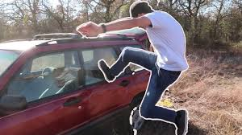
Business Problems: Kick cars
Purchasing a used car at an auto auction is the risk of that the vehicle might have serious issues that prevent it from being sold to customers ("kicks").
The challenge is to predict if the car purchased at the Auction is a Kick (bad buy).
Notes:
One of the biggest challenges of an auto dealership purchasing a used car at an auto auction is the risk of that the vehicle might have serious issues that prevent it from being sold to customers. The auto community calls these unfortunate purchases "kicks".

Slide 3
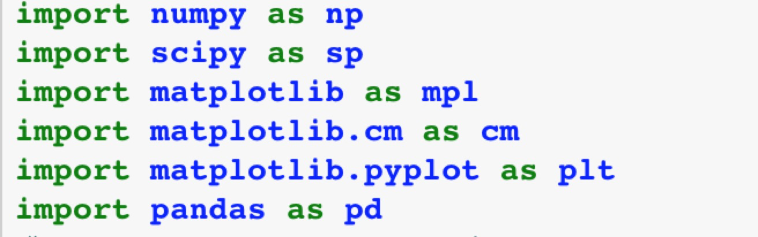
Overview of the data
Libraries we used in this project:
Reading data and show 5 first rows of data to get some sense how data looks like

Slide 4
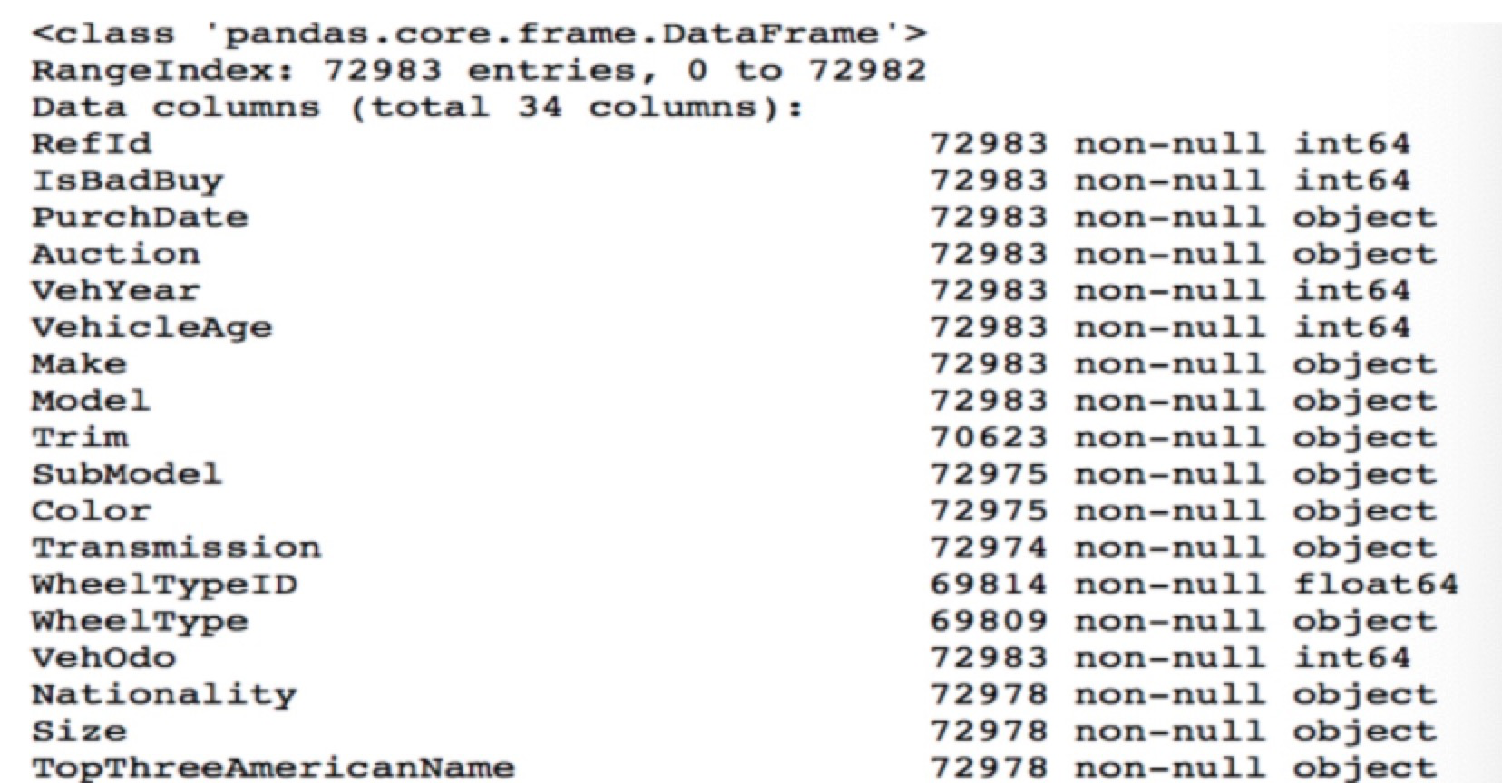
Overview of the data [5]

Slide 5
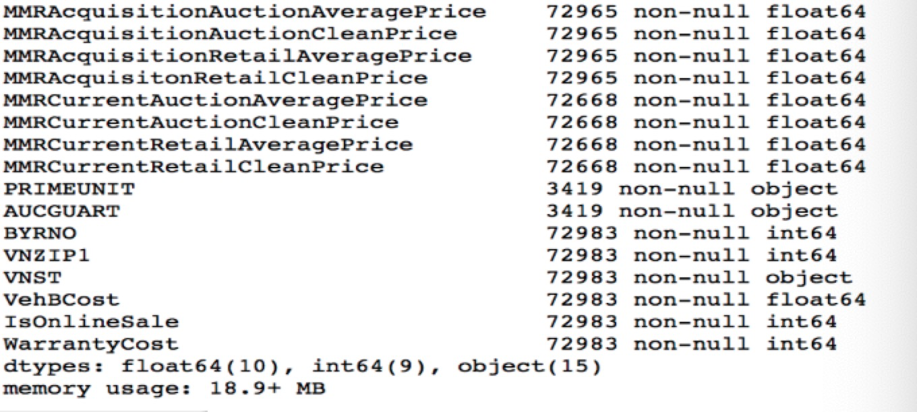
Overview of the data [5]

Slide 6
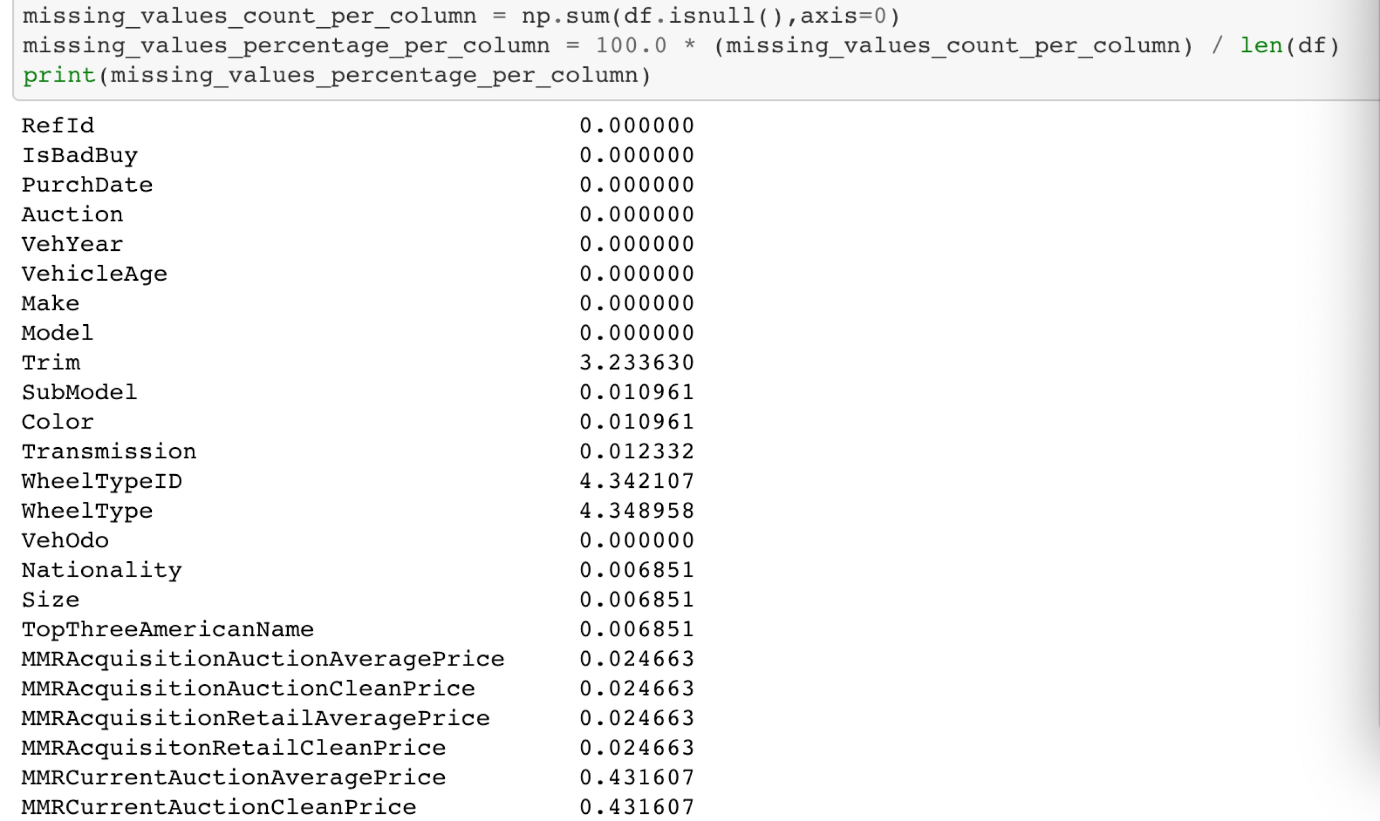
Transformation: Feature Engineering
Finding missing values
No need for Id
VehYear and VehicleAge gives PurchDate
Replaced the missing value NOT AVAIL
Replaced by 0
No need for VehYear and Vehicle Age
Redundant
Replaced the missing value with most frequent category (Auto)

Slide 7
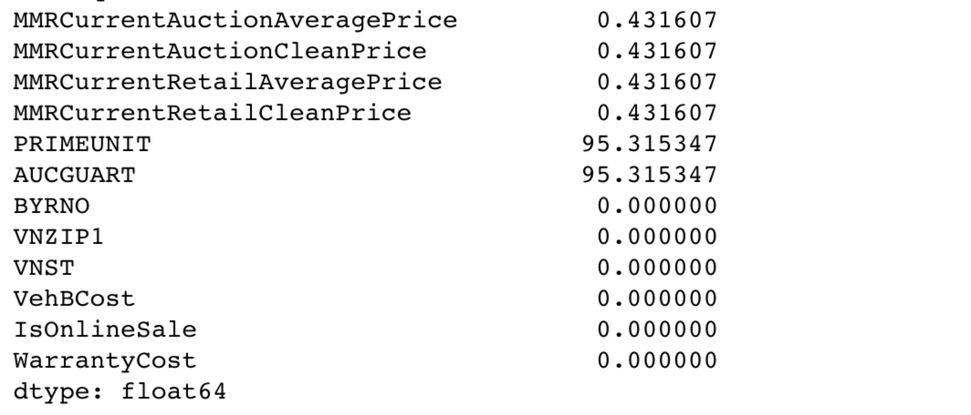
Transformation: Feature Engineering
Too High

Slide 8
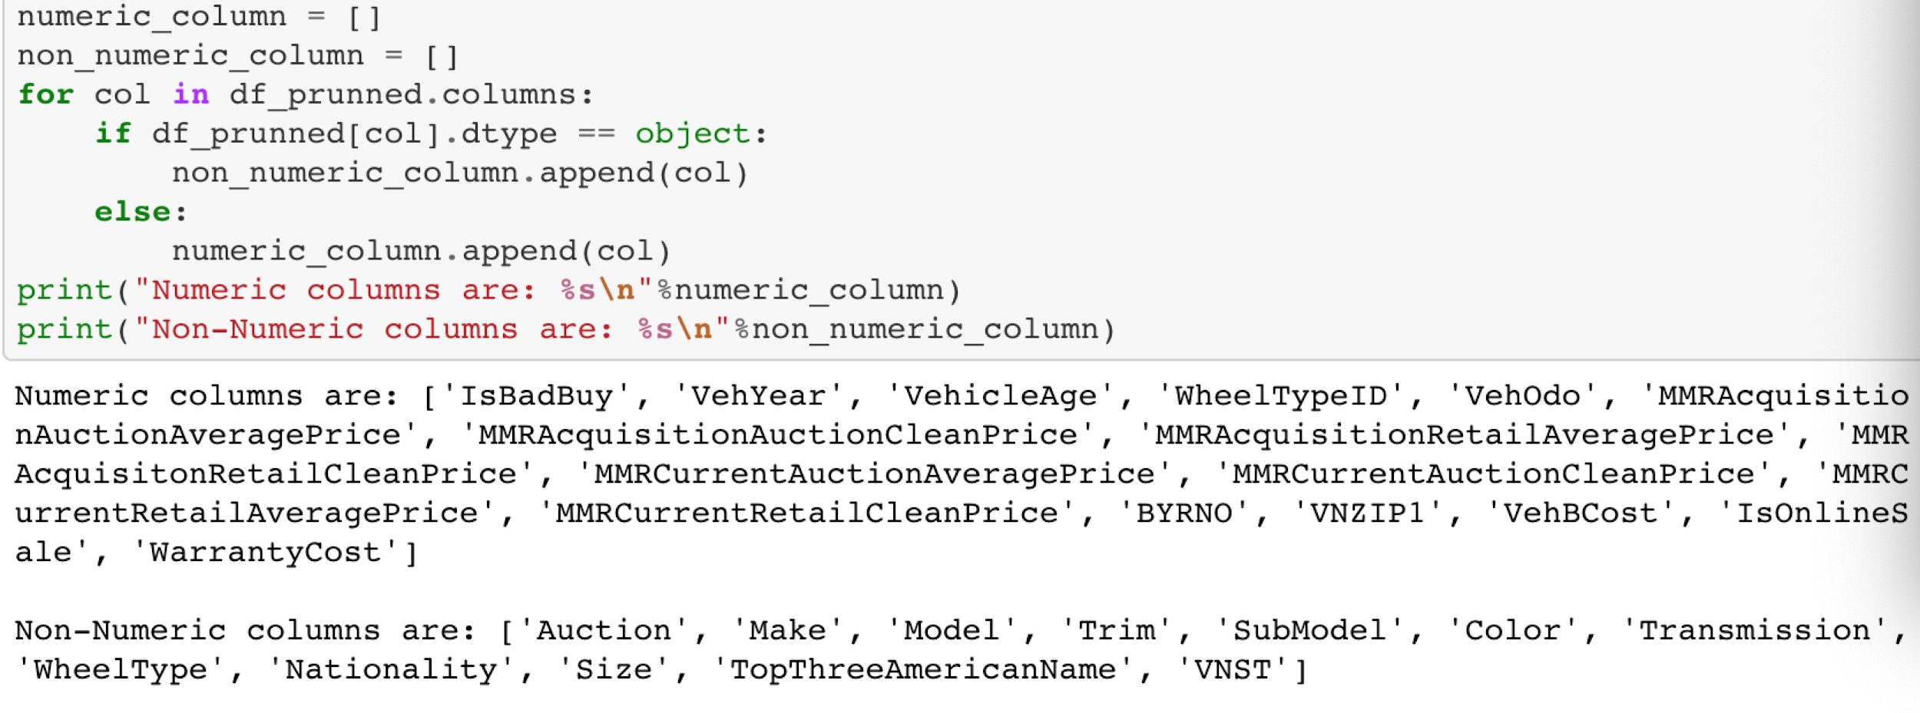
Transformation: Feature Engineering
Numerical and categorical data

Slide 9
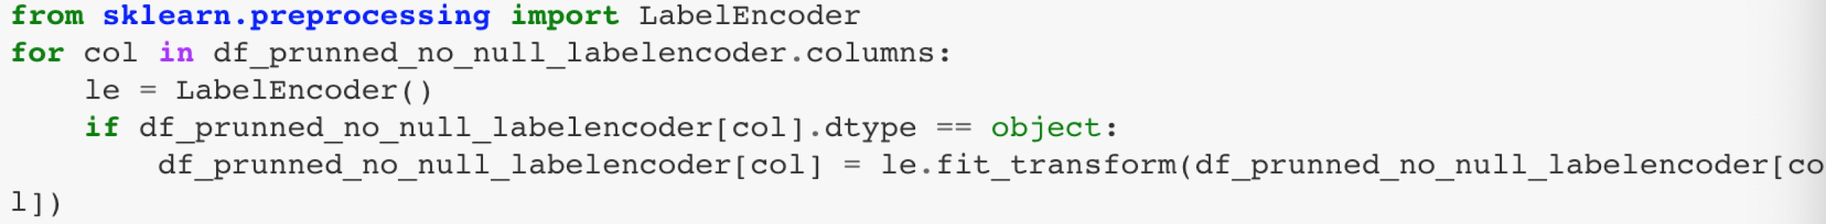
Transformation: Feature Engineering
Apply LabelEncoding to convert Non Numeric (Categorical) features to numerical values in classification models.

Slide 10
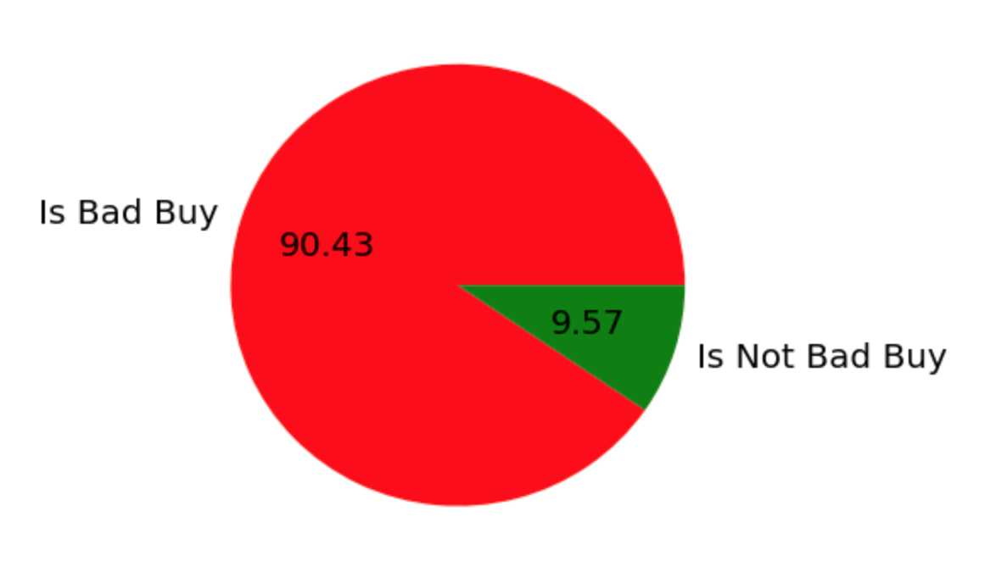
Data Exploration
Distribution of different classes (Is Bad Buy or Is Not Bad Buy)

Slide 11
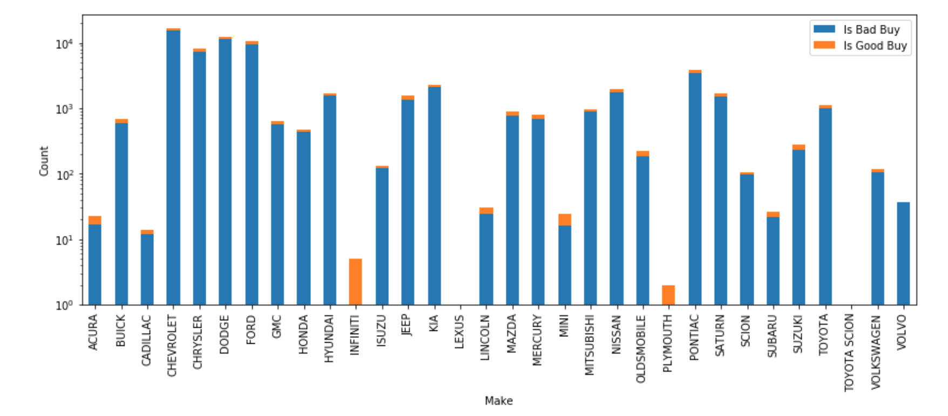
Data Exploration
Distribution of different data features over different classes
Notes:
The following bar chart and table show that the purchased vehicles from specific brands such as Volvo were rarely a kick! However, it should be considered that the number of vehicles purchased varies considerably among different brands.

Slide 12
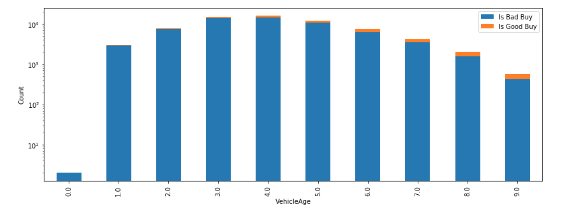
Data Exploration

Slide 13
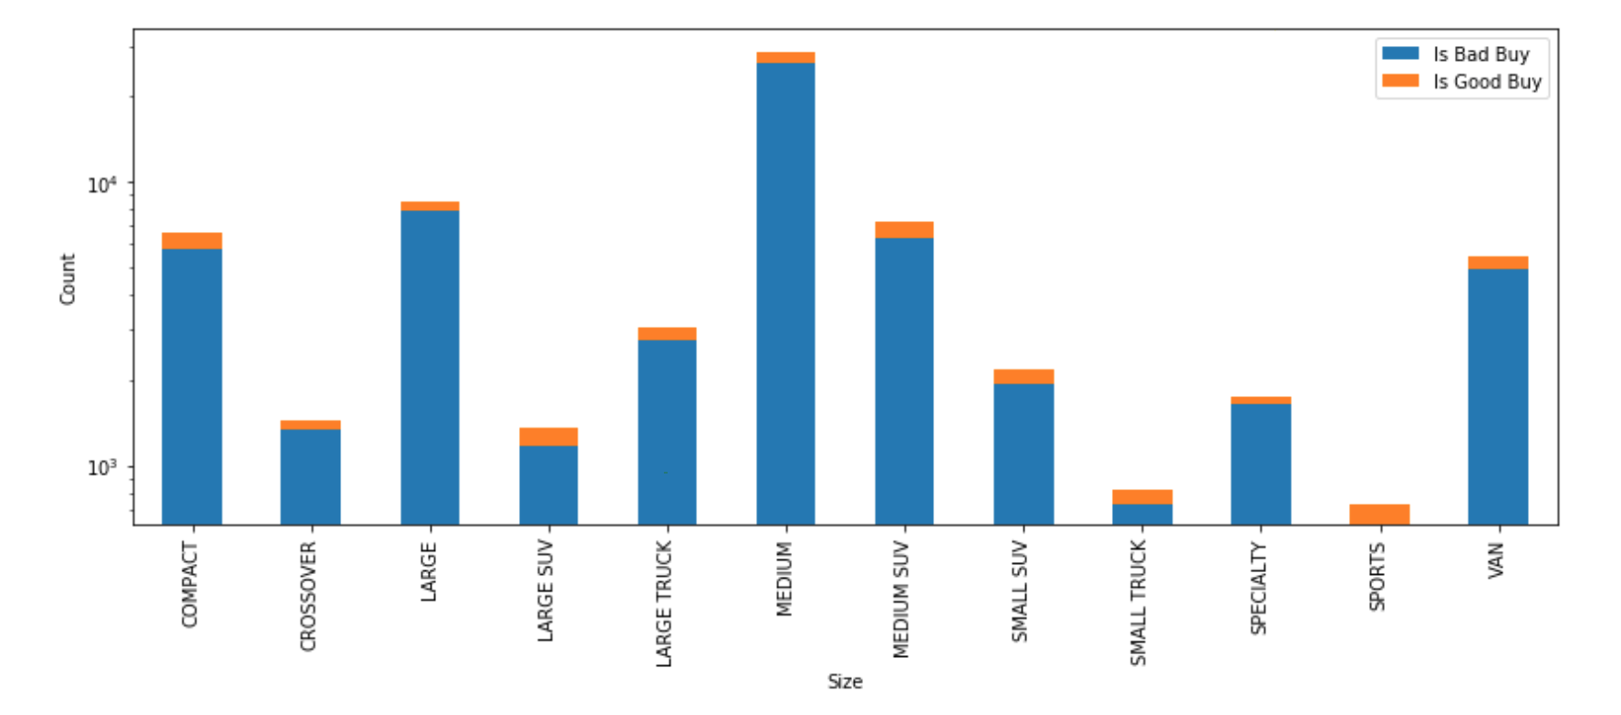
Data Exploration

Slide 14
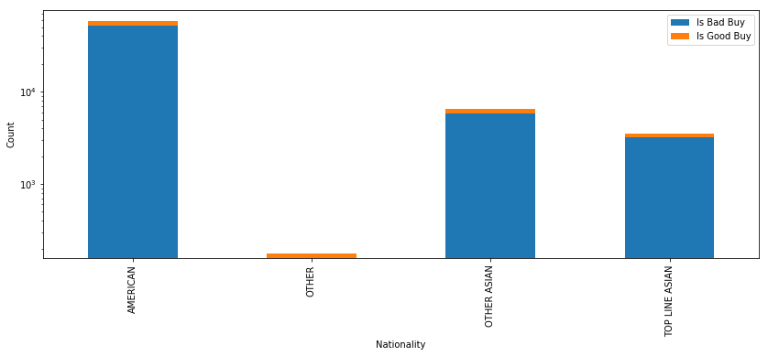
Data Exploration
Now let see how "Nationality" is distributed over different classes

Slide 15
Models you built and why
Splitting data into training and testing with ratio of 20% to 80%.
Avoid Overfitting
Applying Upsampling method on training data due to having unbalanced data

Slide 16
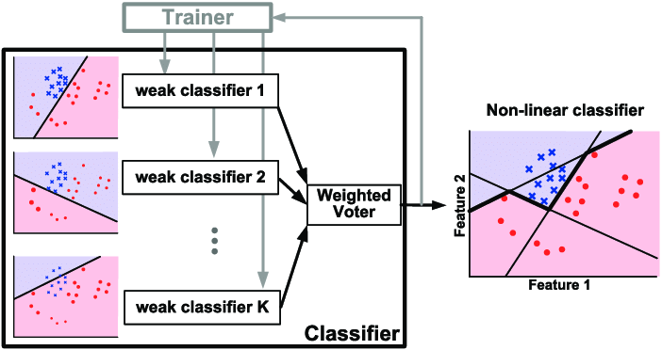
Model
Due to applying LabelEncoding on data, we need non-linear classification model, therefore,AdaBoost classifier with Decision Tree as base is applied.

Slide 17
Model
Comparing current model with RandomForestClassifier
If we have time, we will apply SVM as non-linear classifier and we can compare the results.
Tuning Hyperparameters and get the best one by using GridSearchCV with a default 3-fold cross-validation

Slide 18
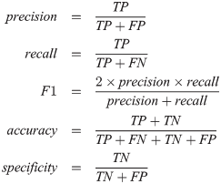
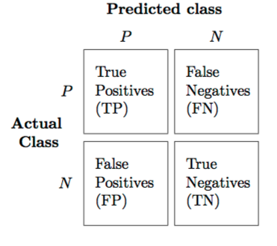
Evaluation
Accuracy
F1 score
Area under curve(AUC)
Confusion matrix

Slide 19

Summary
The purpose of this project is to predict if the car purchased at the Auction is a Kick (bad buy) and try to figure out which cars have a higher risk of being kick, the value of this project is that our study can provide real value to dealerships trying to provide the best inventory selection possible to their customers.
Good Buy
Bad Buy

Slide 20
Reference
[1] Fayyad, Usama and Piatetsky-Shapiro, Gregory and Smyth, Padhraic, From data mining to knowledge discovery in databases, AI magazine, 1996, Volume 17, Number 3, Pages 37
[2] Mennis, Jeremy and Guo, Diansheng Spatial data mining and geographic knowledge discovery—An introduction, Computers, Environment and Urban Systems, 2009, Volume 33, Number 6, Pages 403--408
[3] Han, J., & Kamber, M. 2001. Data mining: Concepts and techniques .Morgan-Kaufman Series of Data Management Systems. San Diego: Academic Press.
[4] Venkatadri, M and Reddy, Lokanatha C, A review on data mining from past to the future, International Journal of Computer Applications, 2011, Volume 15, Number 7, Pages 19-22
[5] https://www.kaggle.com/c/DontGetKicked
Northeastern University
College of Computer Science

